Slide 1
Workshop on Productivity and Innovation in Brazil
1-2 July 2015, Brasilia
Innovation and Productivity in Brazil – New Insights, New Directions
Dirk Pilat, Deputy Director
Directorate for Science, Technology and Innovation
dirk.pilat@oecd.org

Slide 2
Outline
Innovation, productivity and growth
Investing in innovation
Innovation policies, including business-science relationships
Business dynamics, jobs and the role of experimentation
New insights on global value chains

Slide 3
1. Innovation is one of the main drivers of growth and productivity …
Figure 1. Contributions to GDP growth
Total economy, annual percentage point contribution, 1995-2013
Innovation key driver of growth, through:
Technology embodied in fixed capital, e.g. ICT
Investment in knowledge-based capital (later slides)
Productivity growth due to innovation (MFP)
Creative destruction and business dynamism (later slides)
Innovation’s role will have to grow in future, e.g. due to ageing.
Source: OECD Productivity Database, January 2015, and OECD (2015a), OECD Compendium of Productivity Indicators, 2015.

Slide 4
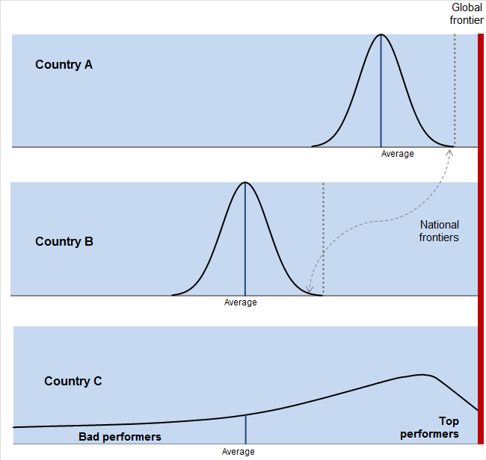
… and involves not only invention, but also adoption and diffusion …
Global frontier
Adoption
convergence
National Frontier
Penetration
divergence
Laggards

Slide 5
… which are affected by a range of factors

Slide 6
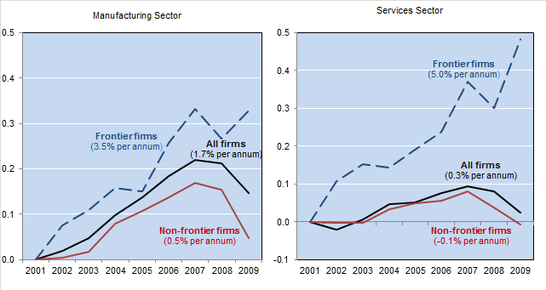
The global productivity frontier is still going strong, but diffusion is lagging
Solid growth at the global productivity frontier but spillovers disappoint
Labour productivity; index 2001=0
Source: Andrews, Criscuolo and Gal (2015), “Frontier firms, technology diffusion and public policy: micro evidence from OECD countries ” forthcoming OECD Working Paper.

Slide 7
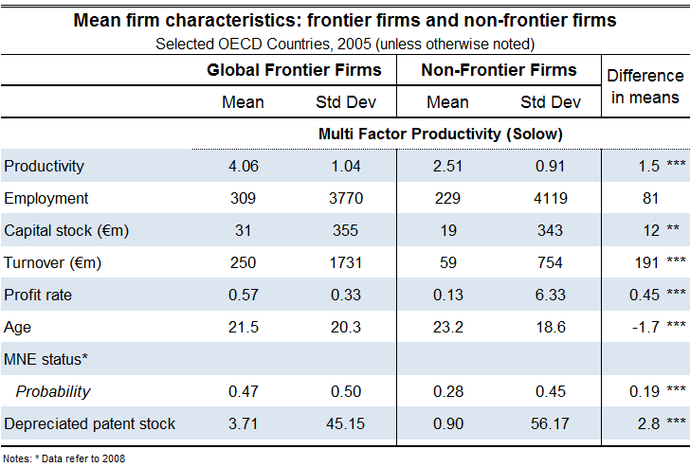
The globally most productive firms: who are they?
Note: “Frontier firms” corresponds to the average labour productivity of the 50 globally most productive firms in each 2
digit sector in ORBIS. “Non-frontier firms” is the average of all other firms.

Slide 8
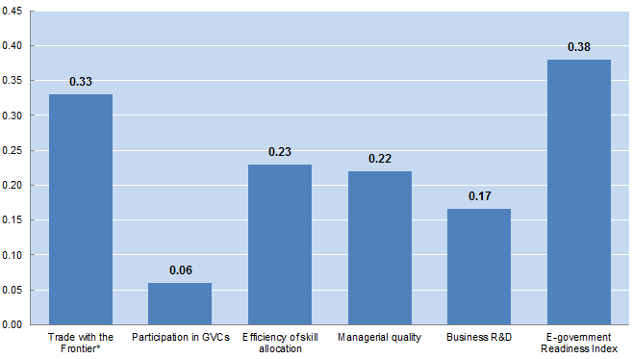
Learning from the global frontier is shaped by key structural factors
Source: Saia, Andrews and Albrizio (2015) % difference in frontier spillover effect between maximum and minimum value of each structural variable, assuming 2% MFP growth at the frontier
Notes:
Notes: Trade with the global frontier measures the intensity of trade with the productivity leader in each manufacturing industry and is based on OECD calculations using OECD, STAN database (Minimum: Austria, Maximum: Canada). GVC Participation is based on the measure in Figure 15 (Minimum: Canada, Maximum: Belgium). Efficiency of skill allocation (Minimum: Italy, Maximum: Belgium) and managerial quality (Minimum: Italy, Maximum: Finland) are sourced from Adalet McGowan and Andrews (2015a). Business R&D is defined as the ratio of business R&D expenditures to value added and sourced from OECD, Main Science and Technology Indicators (Minimum: Australia, Maximum: Sweden). E-government readiness index (Minimum: Greece, Maximum: the Netherlands) is from OECD, Internet Economy Outlook 2012.

Slide 9
2. A growing share of investment is related to innovation …
Business investment in KBC and tangible assets
(as % of business sector value added, 2010)
Source: OECD calculations based on INTAN-Invest, Eurostat and multiple national sources.

Slide 10


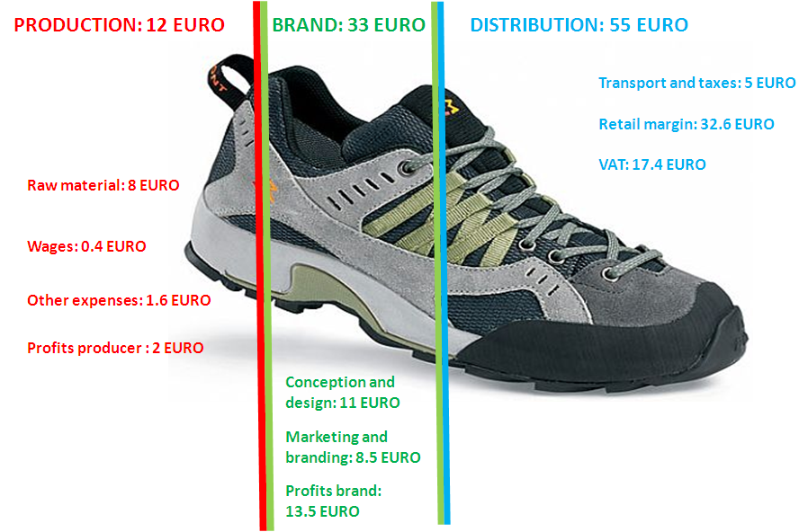



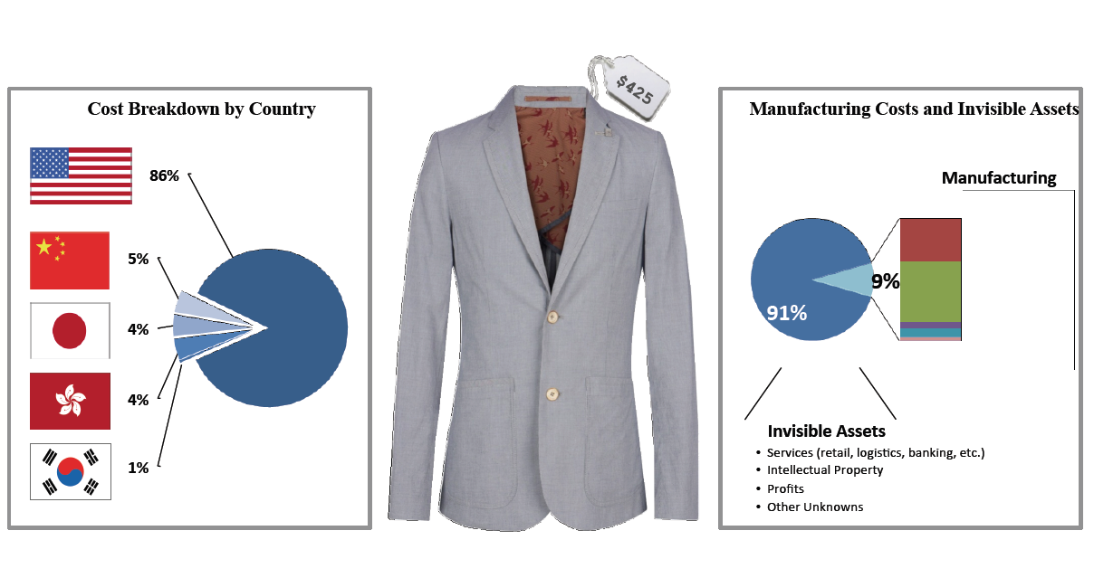
… which is increasingly central to value creation and product differentiation in global markets
SPORT SHOES: 100 EURO (final retail price)
Source: Trudo Dejonghe (Lessius)
Source: IMD (2000) Innovation and Renovation: The Nespresso Story, IMD046, 03/2003. © Nespresso
A SUIT… MADE IN CHINA, SOLD IN UNITED STATES
Source: Fung Global Institute
© General Motors, Chevy Volt

Slide 11
Good framework policies are associated with investment in innovation …

Slide 12
… but resources in some countries don’t flow to the most innovative firms
Change in capital stock associated with a 10% change in patent stock (2003-2010)
Source: Andrews, Criscuolo, and Menon (2014).

Slide 13
Investment in innovation: key policy issues
Business investment in innovation is not just technology and R&D – complementarities and policies affecting other assets are important, e.g. data, design, management, organisational capital, skills, …
As these new assets grow in importance, so do the policies affecting them – e.g. are our IPR systems still fit for 21st century innovation? Are policy frameworks ready for firms’ use of big data?
Enabling resources to flow to more innovative firms – framework conditions matter.
Public investment to support private investment in some areas of innovation, e.g. R&D, education and broadband networks.

Slide 14
3. The specific mix of policies to support business innovation matters, …
Direct funding of business R&D and R&D tax incentives, as a percentage of GDP, 2012
Source: OECD R&D Tax Incentive Indicators, www.oecd.org/sti/rd-tax-stats.htm

Slide 15
… including their design and incidence of benefits
Implied tax subsidy on R&D, by firm size and profit scenario, 2013
Source: OECD R&D Tax Incentives Indicators; based on the 2013 OECD-NESTI data collection on tax incentives support for R&D expenditures http://www.oecd.org/sti/rd-tax-stats.htm).

Slide 16
Though policy needs to recognise that many innovative firms do not undertake R&D
Product Innovation, by R&D Status, 2008-10
Source: OECD, Science, Technology and Industry Scoreboard 2013, http://dx.doi.org/10.1787/888932892480

Slide 17
Well-designed direct support for innovation can work, but some lessons have been learned
Remove barriers before providing support - i.e. “don’t roll a ball up a hill”
Clarity in objective(s) – such that success and failure can be assessed in a non-discretionary manner
Evaluate (preferably ex ante and ex post) – and incorporate evaluation in policy cycle
Learn from experimentation – learn and fail fast
Ensure public bears risk which is “proportionate” (enough to matter, not too much to lead to moral hazard)
Plan for exit – and make plan known in advance
Competition - keep the outsiders and the unborn in mind – resist political economy pressures

Slide 18
Innovation and research: key policy issues
Many countries emphasize (R&D) tax incentives to support business innovation, but these have several drawbacks in strengthening innovation – better design can help reduce such drawbacks
Well-designed and competitive direct support for innovation, e.g. Fraunhofer-type Institutes, accelerators, university-industry relationships, etc., may be better suited to building innovation capabilities, including for firms that do not undertake R&D.

Slide 19
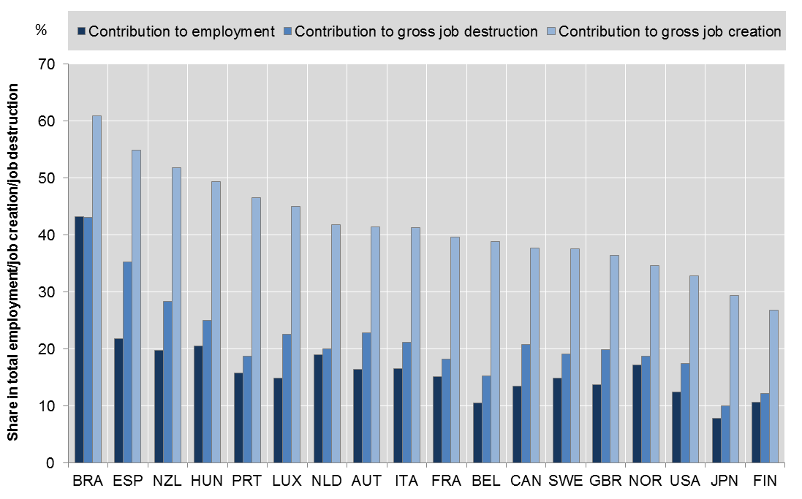
4. Young firms create new opportunities …
Contributions of young firms to employment, job creation and job destruction, 2001-2011
Source: Criscuolo, Gal and Menon (2014), www.oecd.org/sti/dynemp.htm

Slide 20
… but scaling of young innovative firms is a challenge in many countries …
Average size of start-ups and old firms, in persons employed, services sector
Source: Updated from Criscuolo, Gal and Menon (2014), www.oecd.org/sti/dynemp.htm

Slide 21
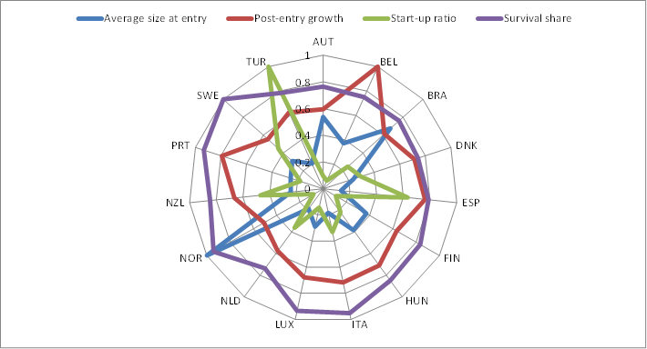
Business Dynamism and The Life Cycle of the Firm: Brazil Relative to Others
Preliminary Results for Brazil:
High Avg Size at Entry but Low Start-Up Rate
Note: the graph illustrates the four components of the growth decomposition normalized over the maximum value across all countries included in the sample.
Source: OECD DynEmp v.2 database. Data for some countries are still preliminary. Data for Brazil developed in co-operation with IPEA.

Slide 22
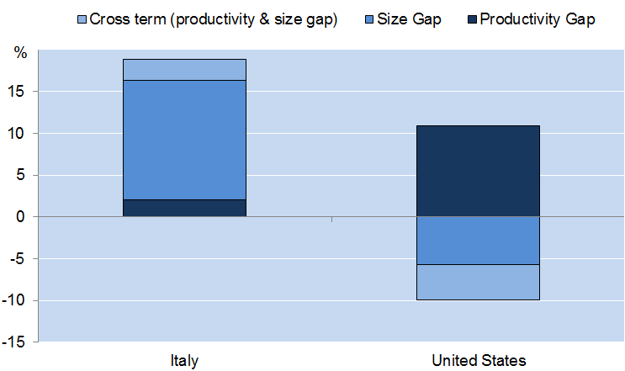
Reducing barriers to scaling increases the impact of firms at the national frontier on productivity
How much higher would overall manufacturing sector labour productivity
be if NF firms were as productive and large as GF firms?
NF firms in Italy have productivity levels close to the GF but they are relatively small
Source: Andrews, Criscuolo and Gal (2015), “Frontier firms, technology diffusion and public policy: micro evidence from OECD countries ” forthcoming OECD Working Paper.

Slide 23
Entrepreneurship and business dynamism – key policy issues
Enable experimentation and firm growth: Reduce barriers to entry (e.g. red tape), growth (e.g. size-specific regulations), and exit/failure of firms (e.g. penalising bankruptcy legislation, overly strict employment protection legislation).
Keep the unborn in mind: Policies often still favour incumbents and MNEs (e.g. R&D tax credits, some environmental regulations, incumbent subsidies that delay exit).
Strengthen the innovation system for innovative firms, e.g. through enhanced access to (risk) capital, network development, mentoring of entrepreneurs, skills development, etc.
Reduce trade barriers, so firms can scale more easily across borders.

Slide 24
Intra- and extra-regional foreign value added in GVCs – Average of TiVA reporters
5. South America is less integrated in global value chains than other regions …
Notes:
Notes: Figure hows the predicted average MFP growth (baseline based on actual GVC participation) and a counterfactual average MFP growth based on raising GVC participation in each country to the average GVC participation for the top 3 performers in each industry for any given year for the manufacturing sector. Industry level productivity is aggregated using country-specific industry value added shares. The estimates are calculated from a regression that controls for country*year and industry fixed effects and is based on a sample of 15 countries for the period 1990-2007.

Slide 25
… and Brazil’s main trading partners are outside the region
Brazil's exports to and imports from main partner countries
percent of total gross and value added exports and imports, 2011
Source: OECD-WTO TiVA database, July 2015
Notes:
Notes: Figure hows the predicted average MFP growth (baseline based on actual GVC participation) and a counterfactual average MFP growth based on raising GVC participation in each country to the average GVC participation for the top 3 performers in each industry for any given year for the manufacturing sector. Industry level productivity is aggregated using country-specific industry value added shares. The estimates are calculated from a regression that controls for country*year and industry fixed effects and is based on a sample of 15 countries for the period 1990-2007.

Slide 26
Services matter for trade, even in manufacturing
Services value added embodied in manufacturing exports, by country
percent of total gross exports, 1995 and 2011
Source: OECD-WTO TiVA database, July 2015
Notes:
Although broadly stable over the last decades, the foreign content of Norwegian exports decreased by 2.7 percentage points between 1995 and 2011. The foreign content of Norway's exports stood at 17.2% in 2011, compared to 17.6% in 2009, but was higher than the pre-crisis level of 16.3% in 2008 (Figure 1). While relatively low compared to similar sized economies, this largely reflects Norway’s specialisation in oil.

Slide 27
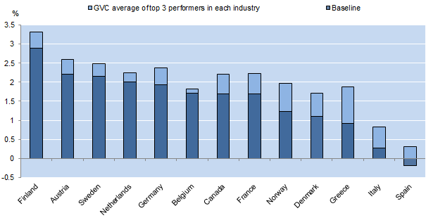
Integration in global value chains can help support productivity growth
Estimated gains to MFP growth associated with raising GVC participation
Source: Andrews, Criscuolo and Gal (2015), “Frontier firms, technology diffusion and public policy: micro evidence from OECD countries ” forthcoming OECD Working Paper.
Notes:
In 2011 the service content of total exports in Norway was 39.3%, below the OECD average of 54.3%, reflecting the significant share of oil exports, which have relatively low services content ( Figure 9).

Slide 28
Some conclusions
Productivity growth at the global frontier is still strong:
The world has not run out of technology or sources of growth
But diffusion of knowledge and innovation remains a challenge
Key policies for innovation include:
Improved policy frameworks for investment in innovation
Innovation policies based on best practice
Enabling entrepreneurship and business dynamism – allow new firms to fail or scale and unproductive firms to exit
Benefiting from the global productivity frontier, including through integration in global networks
A strong focus on evaluation and policy learning
Notes:
In 2011 the service content of total exports in Norway was 39.3%, below the OECD average of 54.3%, reflecting the significant share of oil exports, which have relatively low services content ( Figure 9).

Slide 29


Thank you
Contact: Dirk.Pilat@oecd.org
Read more about our work
Follow us 0n Twitter: @OECDinnovation
Website: www.oecd.org/sti
Newsletter: www.oecd.org/sti/news.htm

Slide 30
SPARES

Slide 31
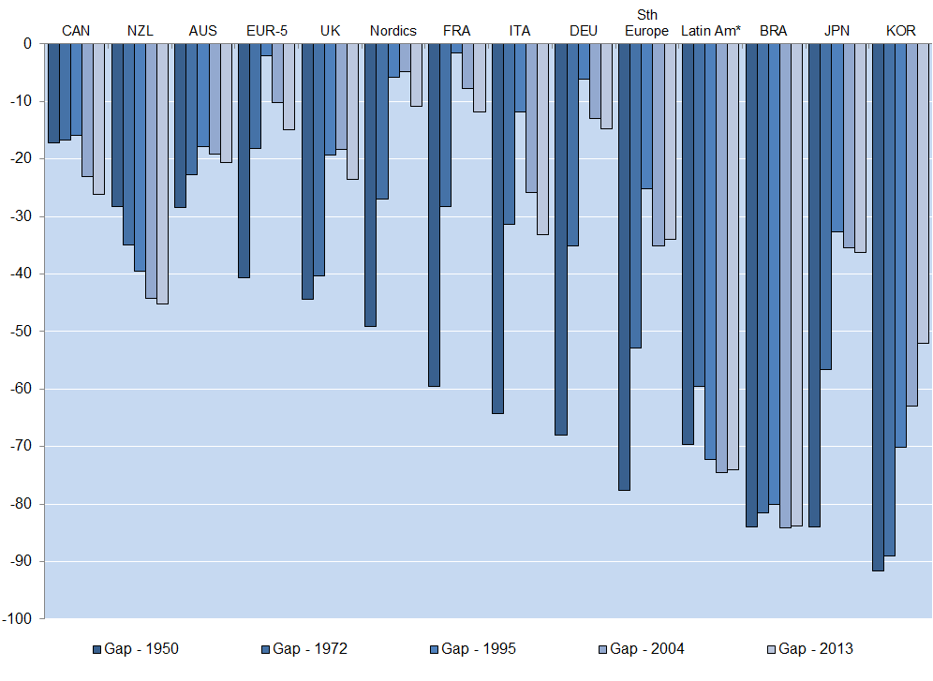
Brazil’s convergence in productivity with the US has stalled
Per cent gap in GDP per hour worked with the United States
Source: Conference Board Total Economy Database

Slide 32
A growing share of business investment is related to innovation …
Business investment in KBC and tangible assets in the United States (% GDP, 1972-2011)
Source: Corrado et al. (2012).

Slide 33
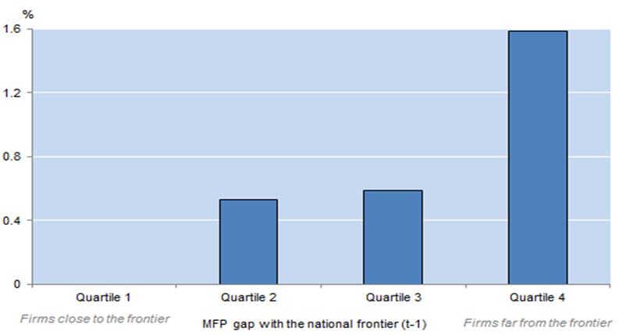
University – industry collaboration can facilitate catch-up of laggards to the national frontier
Impact of policy reforms on the MFP growth of laggard firms, 2005
Increasing Collaboration from low level in France to the OECD average
% difference between industries with high and low knowledge intensity
Source: Andrews, Criscuolo and Gal (2015), “Frontier firms, technology diffusion and public policy: micro evidence from OECD countries ” forthcoming OECD Working Paper.

Slide 34
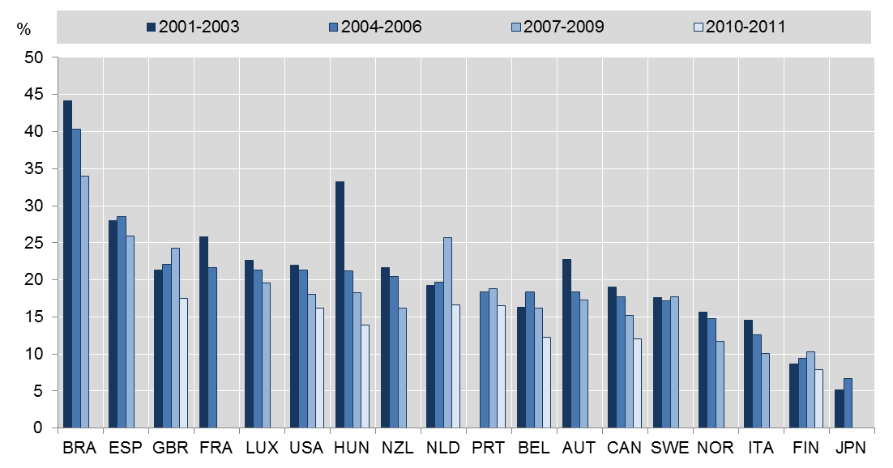
A concern: the share of start-ups is declining in many countries
Share of start-ups among all firms
Note: As a percent of all firms in the total private business sector. Startups are firms aged from 0 to 2. Data for Japan refers to establishment in the manufacturing sector.
Source: OECD, Dynemp Express – preliminary results.

Slide 35
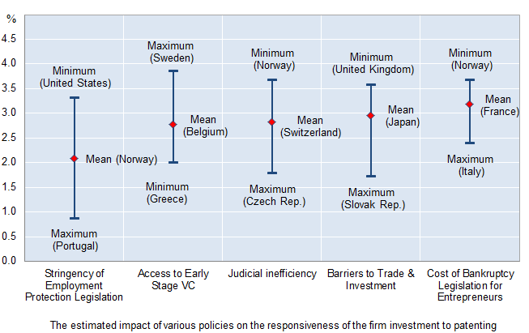
Access to Finance and other Policy Factors Encourage Scaling of Innovative Firms
Additional capital attracted by a firm that increases its patent stock by 10%, 2002-10
Source: Andrews, Criscuolo and Menon (2013).

Slide 36
Brazil is not heavily involved in global value chains
Foreign value added content of gross exports by country percent, 2008, 2009, and 2011 (right insert = time series for Brazil)
Source: OECD-WTO TiVA database, July 2015

